Slide 1


Bragg’s Law
Michael Katz (@MaJiKatz)
www.KatzResearchGroup.com

Slide 2
X-rays
X-rays are electromagnetic radiation
Light
The ones we use for X-ray have a wavelength of 0.7-1.5 Å.
Cu radiation (1.54 Å)
Great for large unit cells (better resolving power between two close data points; compare 600MHz vs. 60MHz NMR data)
Great for chiral molecules
Great for organics
Mo radiation (0.7109 Å)
Great for inorganics
Better resolution
Ag radiation (0.56 Å)
Great for charge densities because it has even better resolution.
How do they interact with matter and give us the information that we are here to learn about?

Slide 3
How Does Electromagnetic Radiation Interact with Matter?
Absorption
Scattering
X=rays
X=rays

Slide 4
X-ray scattering is what we care about
X-rays interact with the electrons in an atom.
X-ray radiation is not absorbed between orbitals
X-ray radiation causes the electrons to move
This causes the electrons to radiate electromagnetic radiation
This can be elastic (same wavelength; we care about)
This can be inelastic (different wavelength; we don’t care about)
This is scattering
With multielectron atoms, the whole electron cloud oscillates (in a predictable way -> the scattering factor of the atom)
The more electrons an atom has, the more it scatters X-rays
Atoms look like point sources of x-rays of the same radiation as the X-ray source.
X=rays

Slide 5


What happens when we have more than one atom?
X-rays

Slide 6
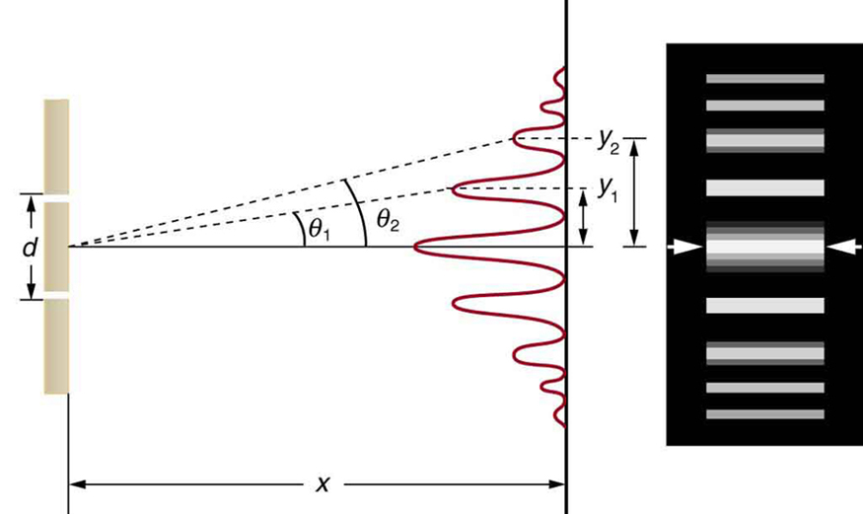
What does this look like?
X-ray Scattering
Young’s Double Slit experiment

Slide 7
Young’s Double Slit Experiment
Young’s double slit experiment tells us information about the distance between the two slits.
Distance information.
Each slit is a new point source of light
Similar to what atoms do when they are hit with X-rays.
The slits are the same size, so there isn’t much we can learn about the slits themselves.

Slide 8
Bragg’s “Double Slit” Experiment
If each new source of x-rays is a different atoms, then the intensity of the x-rays from each atom is different and how they contribute to the observed pattern is different.
Each line contains information about both atoms.
The distances between lines tells us information about the distance between the atoms.
We need a way to collect each of these data points. We need to know where to locate them and how intense they are.
If we can do this, then the information about distance and intensity must tell us about the atom and its position.

Slide 10
Scattering by a crystal
Each atom in the crystal is acting like a new point source of X-rays.
As they leave the crystal, the ordered array of atoms (atoms with fixed distances apart) constructively and destructively interfere to result in a pattern.
This is the diffraction pattern we observe.
Bragg noticed this diffraction pattern and wondered if he could predict where the diffracted beam could be found.

Slide 11
Derivation of Bragg’s Law
Only at some values of the angle θ do we see diffraction
Why?
θ
Distance, d

Slide 12
A Closer Look at Bragg’s Law
For us to see a diffracted X-ray beam, constructive interference must occur.
The beam that travels to the lower plane, travels a longer distance
Longer from the source to the plane (h)
Longer from the plane to the detector (h)
These distances MUST be some whole integer factor of the wavelength
1λ, 2λ, 3λ, 4λ, … nλ
How much more one wavelength travels between the two planes depends on the distance between the two planes.
How?
θ
d
h
h

Slide 13
Bragg’s Law
Sin(θ) = h/d
d*Sin(θ) = h
2d*Sin(θ) = 2h
Recall that the distance 2h must be equal to n*λ
2d*Sin(θ) = n*λ ← Bragg’s Law
If we have parallel planes in a crystal a distance, d, apart, then only when the X-rays hit the plane at an angle, θ, where the extra distance, 2h, travelled by longer path is equal to nλ do we have constructive interference (diffraction).
θ
θ
d
h
h

Slide 14
What are these planes? What are these distances?
2d*Sin(θ) = n*λ
If we have parallel planes in a crystal a distance, d, apart, then only when the X-rays hit the plane at an angle, θ, where the extra distance, 2h, travelled by longer path is equal to nλ do we have constructive interference (diffraction).

Slide 15
What are these planes? What are these distances?
We can draw an infinite number of parallel planes through a crystal
The family of planes are a distance d apart from each other
Only when we satisfy Bragg’s Law, do we see “diffraction” from the planes
2d*Sin(θ) = n*λ

Slide 16
What are these planes? What are these distances?
z
In 1839, William Hallowes Miller came up with a notation for these planes.
Miller Planes
We don’t need to consider the whole crystal. We just need to look at the unit cell
Parallel planes in a unit cell are parallel planes in a crystals
c
b
y
a
x

Slide 17
What are these planes? What are these distances?
z
Every plane that we can draw in the unit cell, intersects at some fraction of the way along the unit cell axis (a, b, c).
We care about the fraction because not all unit cells have the same lengths.
The orange plane:
Intersects a at 0.5
Intersects b at 0.5
Intersects c at 1
The purple plane:
Intersects a at 1
Intersects b at 0.5
Intersects c at 0.33
c
We call this the (2 2 1) plane
b
y
a
We call this the (1 2 3) plane
x

Slide 18
Miller Planes
z
We refer to these planes as (h k l)
h is the inverse of the fractional coordinate along a
k is the inverse of the fractional coordinate along b
l is the inverse of the fractional coordinate along c
We can have planes where the index is zero
We can have negative planes too
c
b
y
a
x
http://katzresearchgroup.com/Miller.html

Slide 19
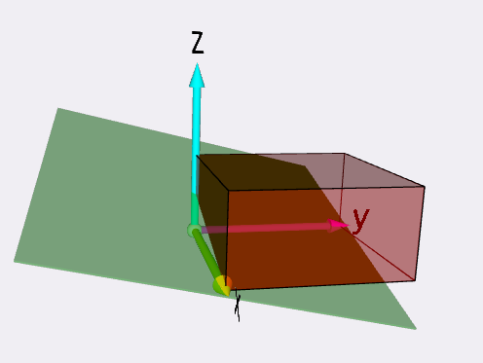
Miller Plane (viewer)
z
c
b
y
a
x
http://KatzResearchGroup.com/Miller.html

Slide 20
Distances between planes
For every plane we draw, we can draw the same parallel plane in all the neighbouring unit cells
This creates a family of planes that are all parallel to one another.
Bragg’s Law!
We need the distance between parallel planes!

Slide 21

Distances between planes
Cubic:
$\frac{1}{d^{2}}=\frac{h^{2}+k^{2}+l^{2}}{a^{2}}$
Tetragonal:
$\frac{1}{d^{2}}=\frac{h^{2}+k^{2}}{a^{2}}+\frac{+l^{2}}{c^{2}}$
Orthorhombic:
$\frac{1}{d^{2}}=\frac{h^{2}}{a^{2}}+\frac{k^{2}}{b^{2}}+\frac{l^{2}}{c^{2}}$

Slide 22
Let’s put it all together
Electrons scatter X-rays
Each atom is thus a source of new X-rays
In an ordered array of atoms (a crystal), this leads to constructive and destructive interference
Each type of atom has its own response to X-rays.
We observe a diffraction pattern.
Because all atoms are interacting with each other to form the diffraction pattern, every atom can contribute to every Bragg reflection we observe.
Bragg determined what conditions were necessary to get diffraction.
Miller created a notation so that we can define any set of parallel planes.
Miller planes, hkl reflections, ….
If we know the unit cell length, then we can predict the distance between any parallel set of hkl planes.
We can then determine at what angle we will see diffraction.
We can determine the intensity of that diffraction pattern.
We can reverse engineer the atoms and their positions that caused this.
We can get a crystal structure!!!!!

Slide 23
Thank you!
Michael Katz (@MaJiKatz)
www.KatzResearchGroup.com

